Slide 1
Acceleration of the Smith–Waterman algorithm using single and multiple graphics processors
Author : Ali Khajeh-Saeed, Stephen Poole, J. Blair Perot.
Publisher: Journal of Computational Physics, 2010
Speaker : De Yu Chen
Data: 2010/11/24

Slide 2
Outline
Introduce to CUDA
Basic algorithm
Parallel scan Smith-Waterman algorithm
Multiple GPUs
Results

Slide 3
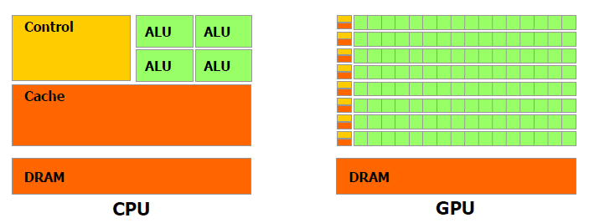
Introduce to CUDA
CUDA(Compute Unified Device Architecture) allows the programmer to program
for NVIDIA graphics cards with an extension of the C programming language
(called CUDA C).
In CUDA, parallelized programs are launched from a kernel of code. The code on
the kernel is run on several thousands of threads. Individual threads run all of the
code on the kernel, but with different data. The kernel can be very small, or can
contain an entire program.

Slide 4
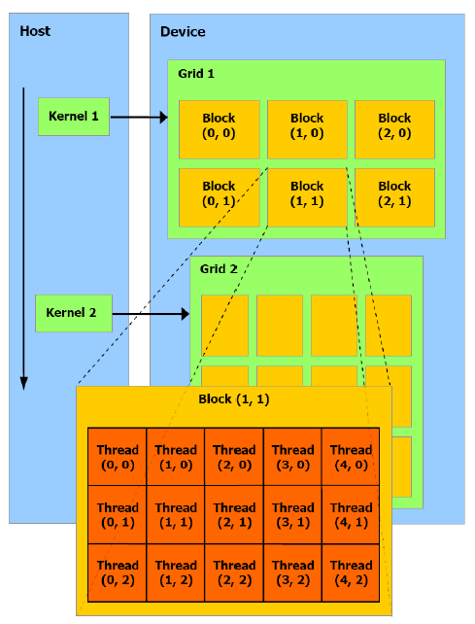
Introduce to CUDA (count.)
In the CUDA, CPU also called host, GPU also called device.
When you programming, you have to choice:
Number of grids?
Number of blocks per grid?
Number of threads per block on same grid?
CUDA architecture

Slide 5

Introduce to CUDA (count.)
Grid 1
On the GPU, a hierarchy of memory architecture
is available for the programmer to utilize.
1. Registers: Read-Write per-thread
2. Local Memory: Read-write per –thread
3. Shared Memory: Read-write per-block
4. Global Memory: Read-write per-grid
5. Constant Memory: Read-only per-grid
6. Texture Memory: Read-only per-grid
Constant Cache
Texture Cache
Device Memory
CUDA architecture with hierarchy of memory

Slide 6
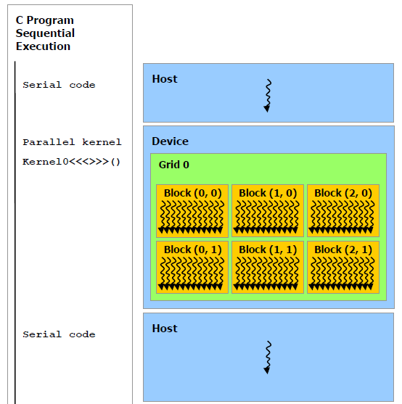
Introduce to CUDA (count.)

Slide 7
Introduce to CUDA (count.)
Bank conflicts problem
Shared memory has 16 banks that are organized such that successive 32-bit
words are assigned to successive banks, i.e. interleaved. Each bank has a bandwidth
of 32 bits per two clock Cycles.
Assume the program have 1 block and 16 threads per block
__global__ void kernel( )
{
__shared__ int shared [16] ;
int id = threadIdx.x ;
char data = shared [id] ;
}

Slide 8
Introduce to CUDA (count.)
8-bit and 16-bit accesses typically generate bank conflicts. For example, there
are bank conflicts if an array of char is accessed the following way:
__global__ void kernel( )
{
__shared__ char shared [32] ;
int id = threadIdx.x ;
char data = shared[id] ;
}
because shared[0], shared[1], shared[2], and shared[3], for example, belong to
the same bank. There are no bank conflicts however, if the same array is accessed
the following way:
char data = shared[ 4 * id ];

Slide 9

Basic algorithm
The Smith-Waterman uses affine-gap penalty as following :
Where Gs is gap start-penalty, Ge is gap extension-penalty.

Slide 10
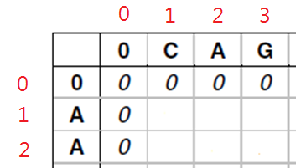
Parallel scan SW algorithm
Basic idea
(1)
(1)
(2)
(2)
Let:

Slide 11
Parallel scan SW algorithm (count.)
The new formula of (1),(2) as following :
(3)
(4)
(3) into (4) :
(3)
(5)

Slide 12
Parallel scan SW algorithm (count.)
For every cell in same row, it’s should be pass three step:
Step 1:
Step 2:
Step 3:

Slide 13
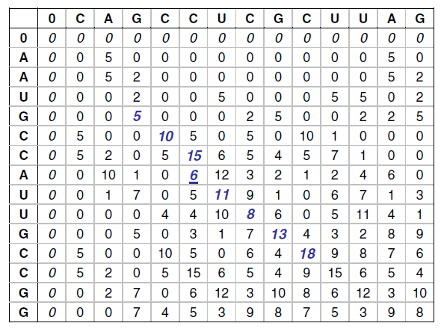
Parallel scan SW algorithm (count.)
My implement
for ( 1 to query sequence length )
{
Kernel<<<1, database sequence
length >>>( arg1, arg2,….)
}
For Kernel, it’s execute Step1~Step3,
and insert “__syncthreads( )” instruction
between Step1 and Step2 to make sure that
every threads should be complete Step1 before enter Step2.

Slide 14
Multiple GPUs
It is possible to trivially use the previous algorithm on up to four
GPUs which are installed on a single motherboard using SLI (Nvidia)
technology. This involves an additional physical connection between
the GPUs. However, for large collections of GPUs operating on
different motherboards and communicating via the network, a more
complex parallelization and implementation strategy is necessary.

Slide 15
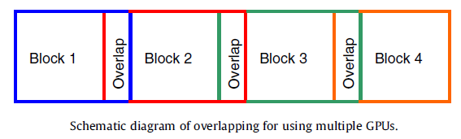
Multiple GPUs (count.)
To use N GPUs, the Smith–Waterman table is decomposed into N
large, and slightly overlapping blocks. The idea is shown as following

Slide 16
Results
Hardware environment.
Nvidia 9800 GT has 112 cores, memory bandwidth is 57.6 GB/s.
Nvidia 9800 GTX has 128 cores, bandwidth is 70.4 GB/s.
Nvidia 295 GTX comes as two GPU cards that share a PCIe slot. When we refer to a single 295 GTX we refer to one of these two cards, which has 240 cores and a memory bandwidth of 111.9 GB/s. For the parallel timings a PC that contains 2 Nvidia 295 GTX cards containing a total of 4 GPUS was used.
CPU is an AMD quad-core Phenom II X4, operating at 3.2 GHz, it has 4 512 KB of L2 cache and 6 MB of L3 cache.

Slide 17
Results (count.)
Software environment
All code was written in C++ with Nvidia’s CUDA language
Extensions for the GPU, and compiled using Microsoft Visual Studio
2005 (VS 8) under Windows XP Professional x64. The bulk of
Nvidia SDK examples use this configuration.
The SSCA#1 benchmark was developed as a part of the high
productivity computer systems (HPCS) benchmark suite that was
designed to evaluate the true performance capabilities of Super-
computers. It consists of 5 kernels that are various permutations
of the Smith–Waterman algorithm.

Slide 18
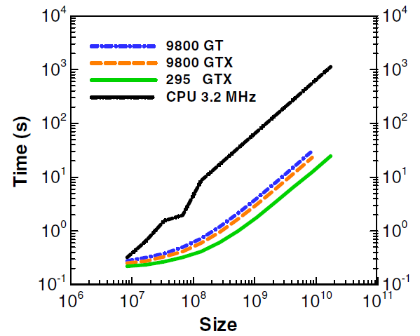
Results (count.)
In the first kernel the Smith–Waterman table is computed and the
largest table values (200 of them) and their locations in the table are
saved. These are the end points of well aligned sequences.

Slide 19
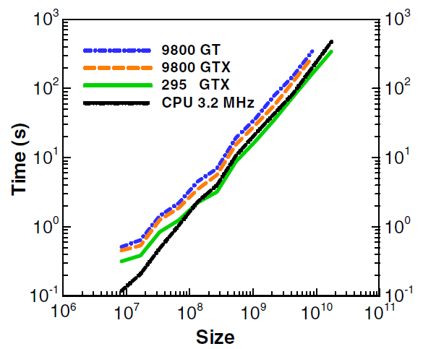
Results (count.)
Timings for kernel 3 of the SSCA #1 benchmark are shown in
Fig.7(b). Kernel 3 is similar to kernel 1 in that it is another Smith–
Waterman calculation. However in this case the sequences are required
to be computed at the same time (in a single pass) as the table evalu-
ation.

Slide 20
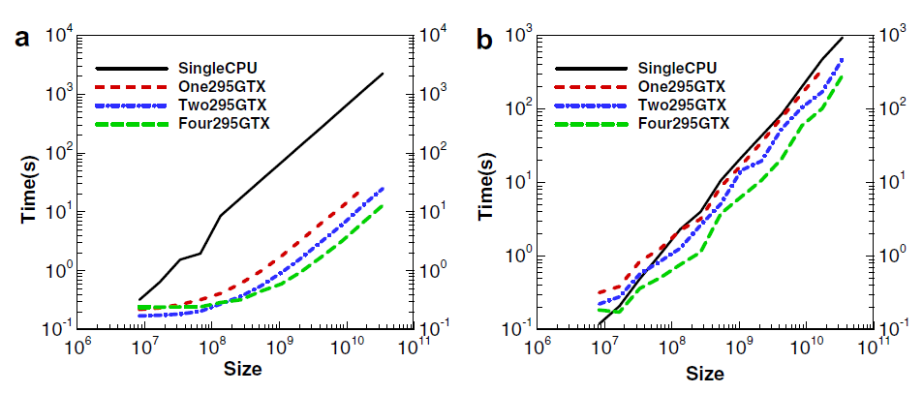
Results (count.)
The parallel performance (for kernels 1 and 3) of using up to four
GPUs is shown below:

Slide 21
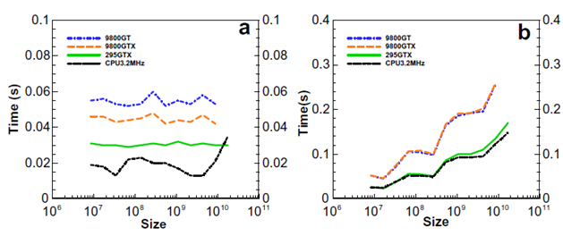
Results (count.)

